Slide 1
Noise analysis of Spheroids
1/26/23
Daniel George
Bleris Lab

Slide 2
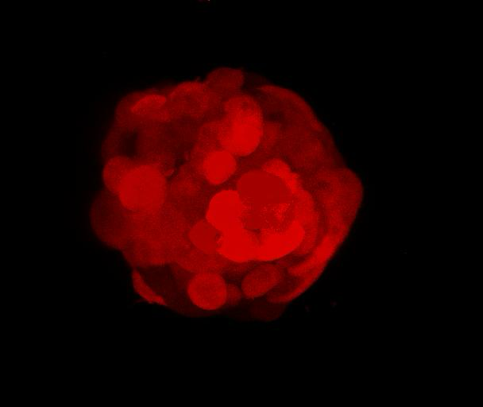
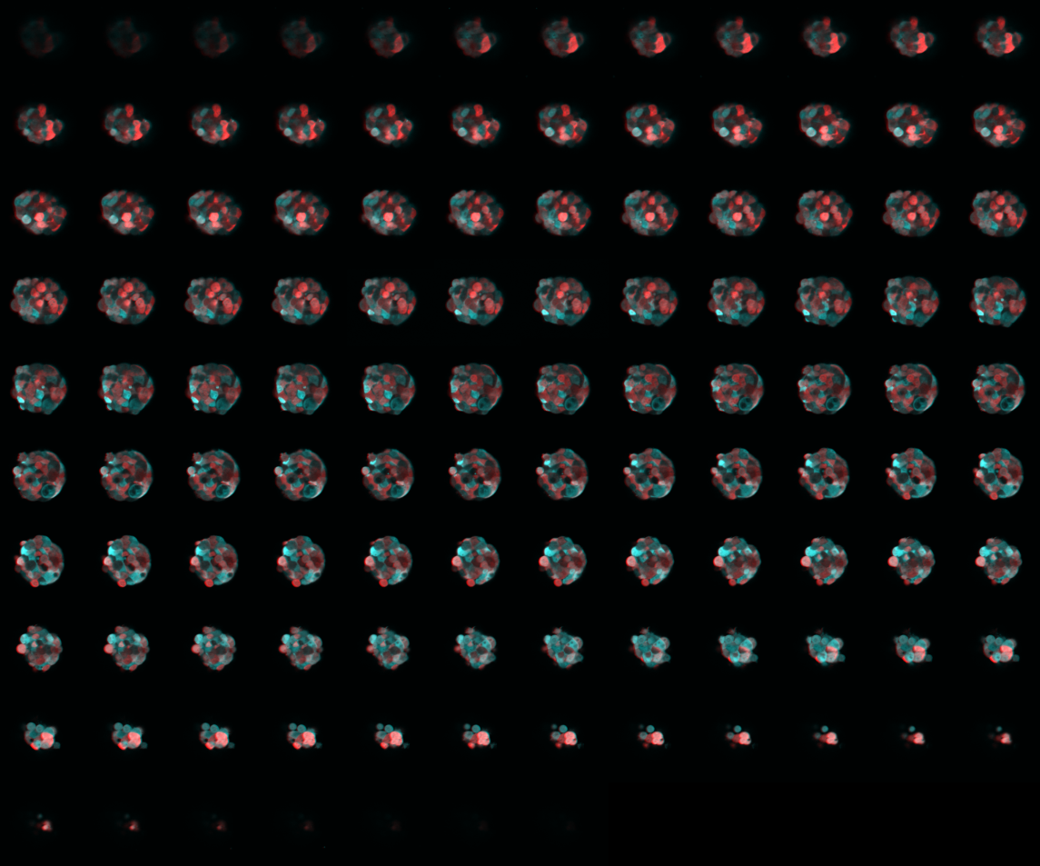
Spheroid data
Slices: 115
Analysis on 12-91
Fluorescence of cell line: CFP and mKate2
What was used: Two-photon microscopy

Slide 3
Goal / hypothesis
Decompose total noise into extrinsic and intrinsic noise in a segmented fluorescence image of the spheroid
Hypotheses:
Cells in the outer layer of the spheroid are different than those in the inner layer in terms to their access to oxygen and nutrients.
Slices from the very top and bottom of the spheroid should consist mainly of cells from the outer layer.
Since extrinsic noise can be affected by access to oxygen and nutrients, there should be an increase in extrinsic noise as you progress towards the center.
Intrinsic noise should not change

Slide 4
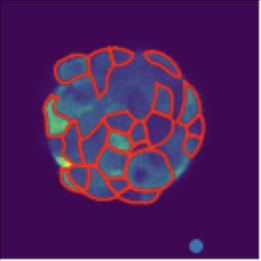
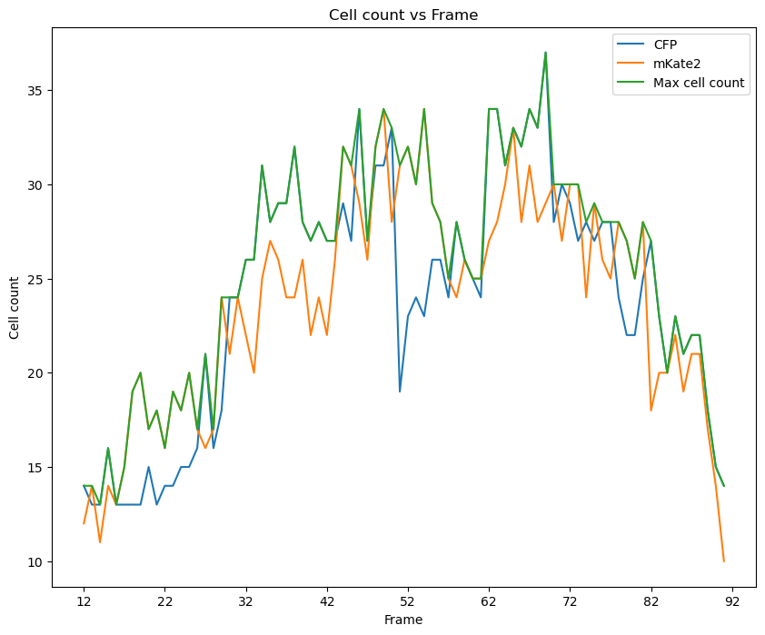
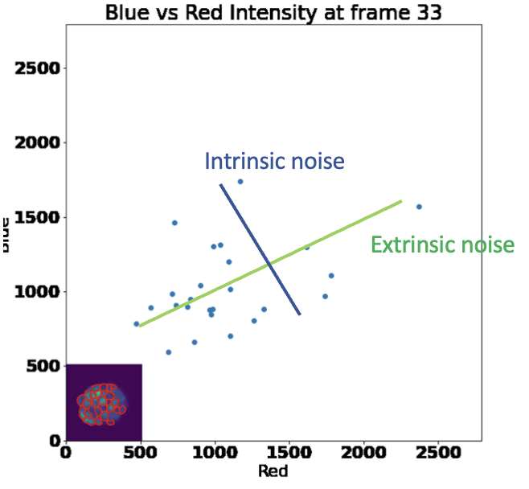
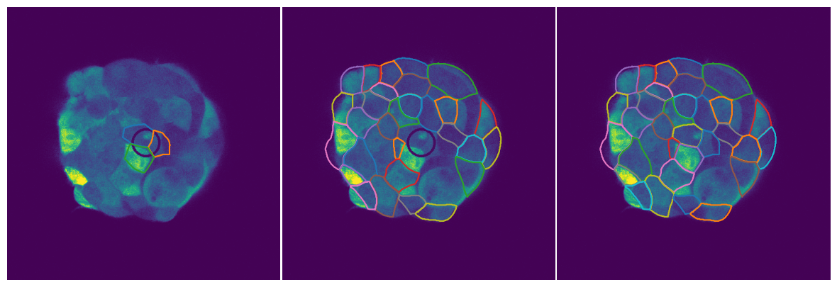
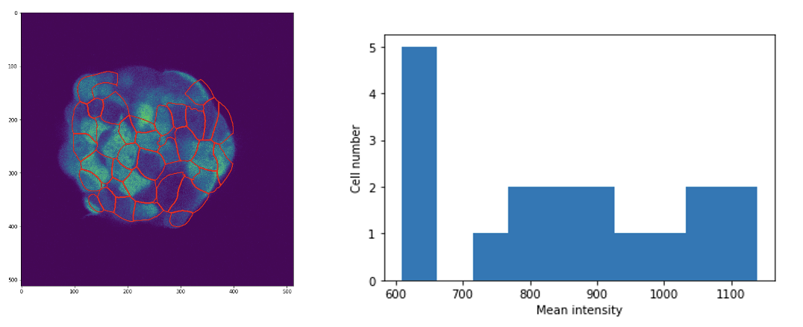
Process overview
1. Segmentation
3. Create inner and outer regions
5. Intrinsic and extrinsic noise calculation
2. Data Augmentation
4. Calculate mean for each segmented cell

Slide 5

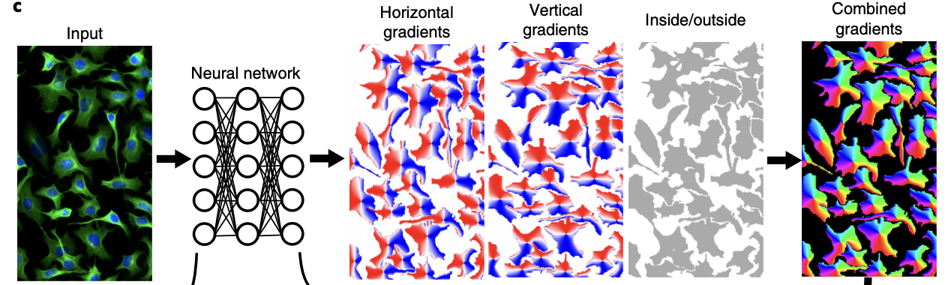
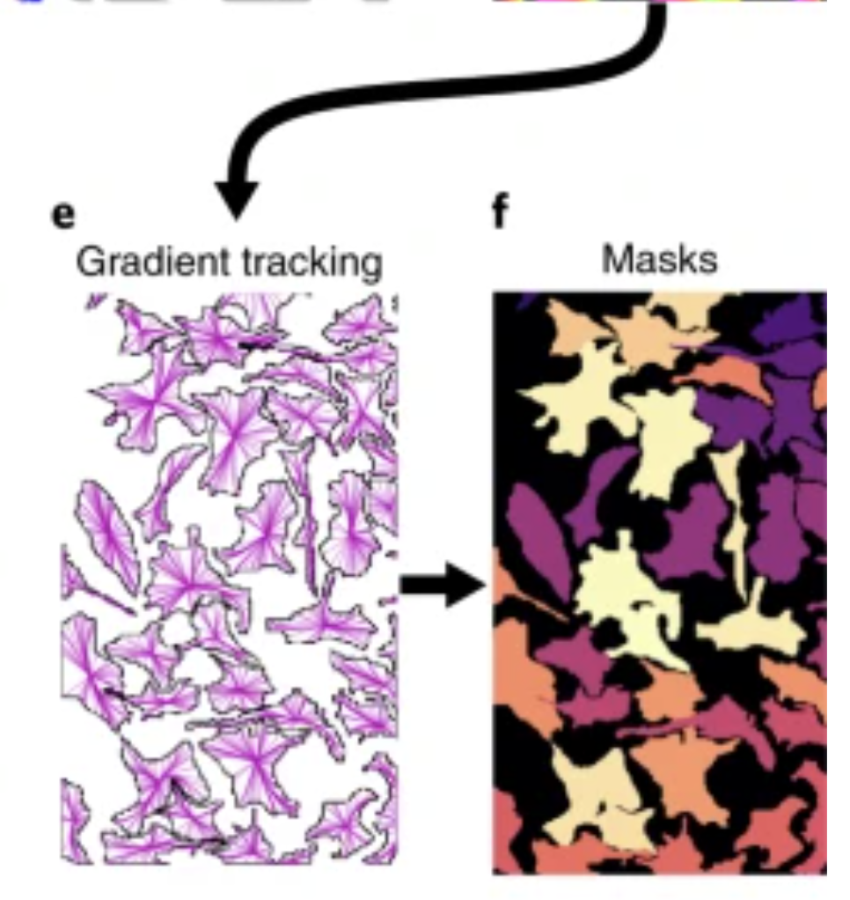
1. Segment
Cellpose algorithm (Stringer et al. Nature Methods 2021)
Outputs the boundaries of different cells
Notes:
Classical segmentation that was used involves the watershed algorithm which has to do with treating the image as a topological map and finding basins. Doesn’t work well with a lot of data because it is messy. This algorithm trained a modified U-net neural net to create an intermediary that is easier to segment. The intermediary is a vector flow representation of a simulated diffusion process. After they are combined, the gradient vector fields make a dynamical system where the pixels go to a fixed point. The pixels that all converge to a certain fixed point becomes a mask.
They also added an extra parameter to consider that different data types have different styles of segmentation.

Slide 6
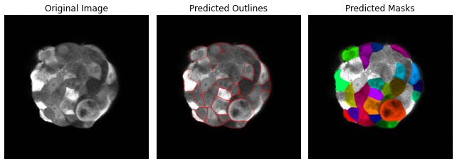
Segmentation example
Cellpose algorithm
Outputs the boundaries of different cells
Ex. frame 54

Slide 7
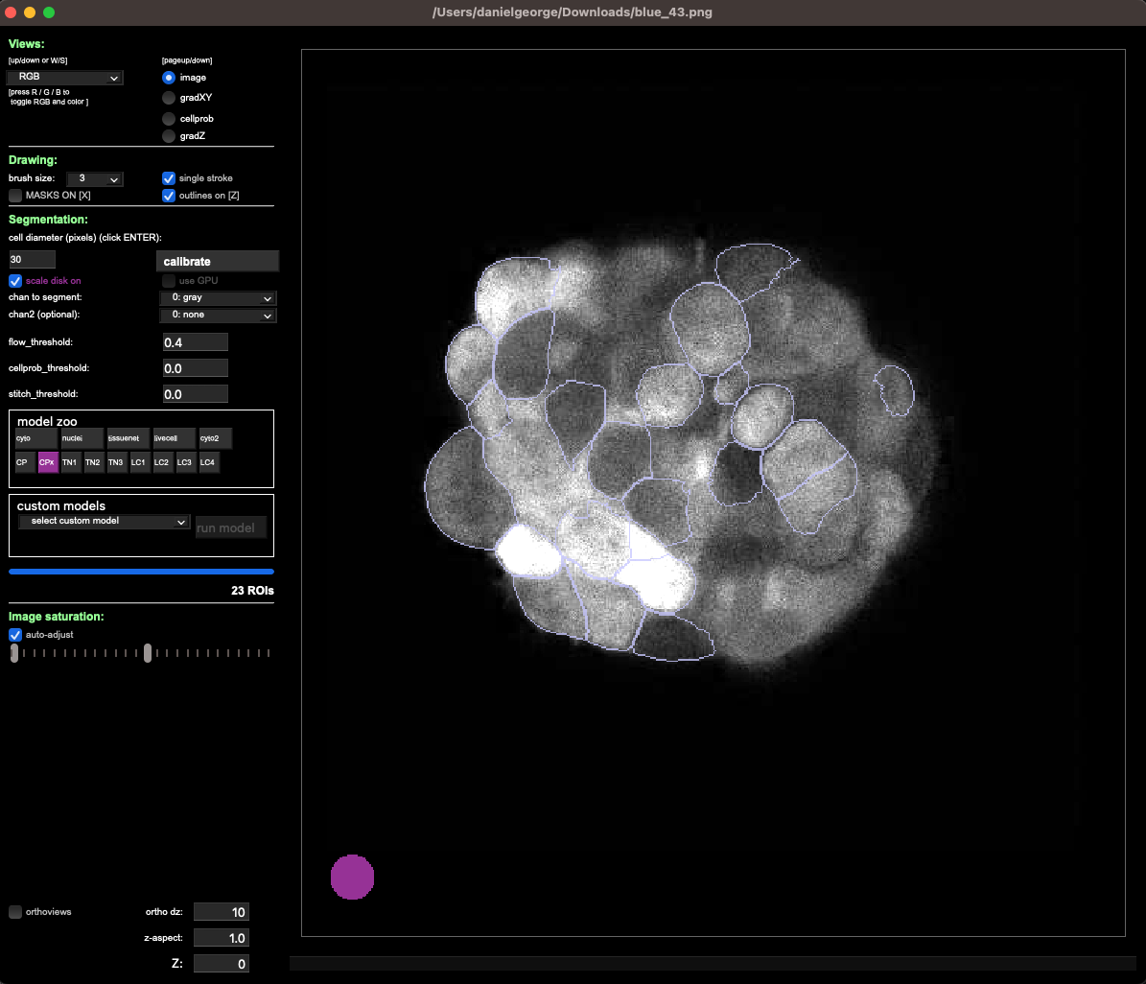
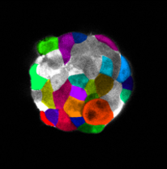
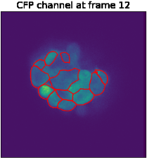
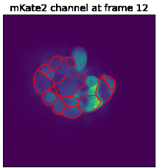
Current segmentation workflow
Use GUI to
Find average cell diameter
Pick best pretrained network
Choose channel to create segmentation
Choose which segmentation has the most cells
Iterate through outlines of different cells and do statistical analysis on intensities

Slide 8
2. Data Augmentation
Problem:
- Each frame has few cells

Slide 9
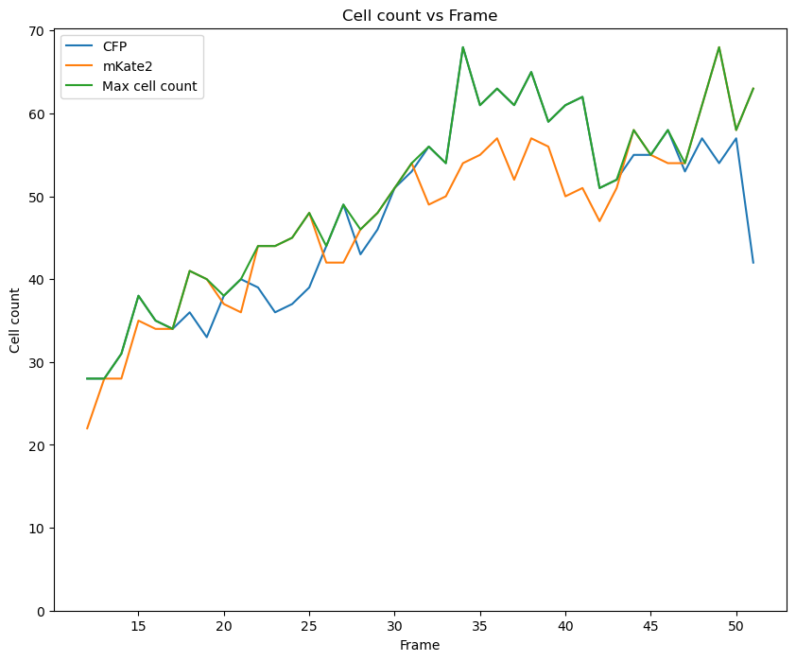
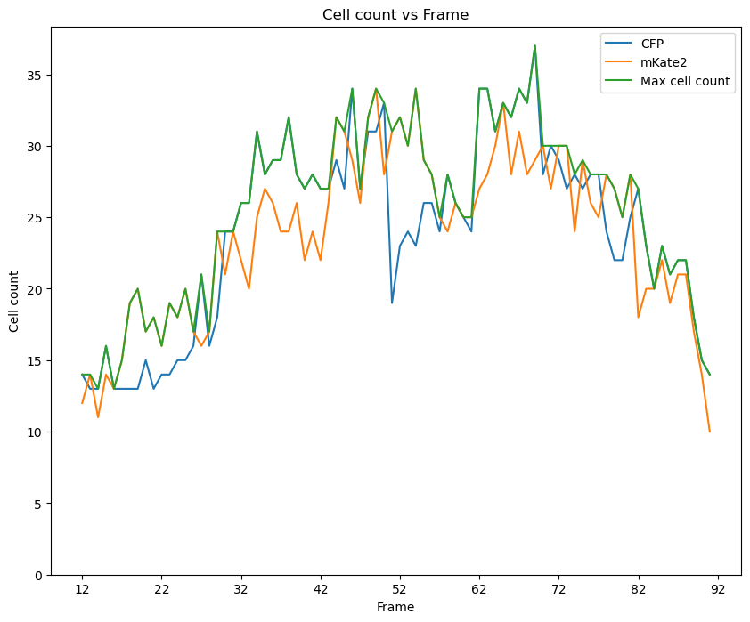
2. Data Augmentation
Possible solution:
- Use symmetry to augment data

Slide 10
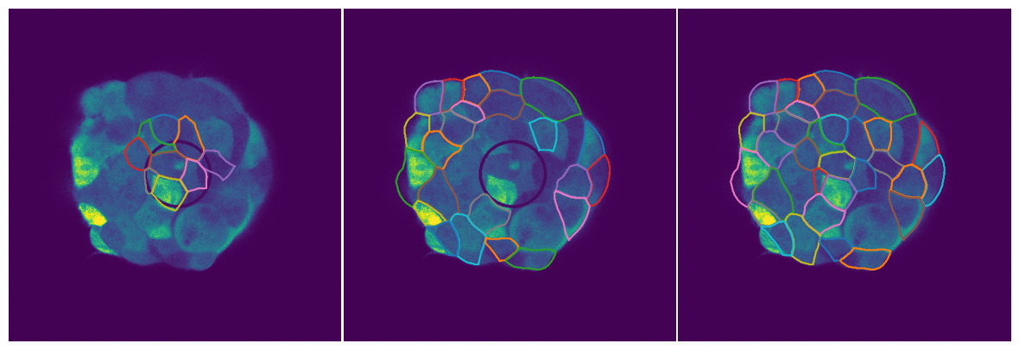
3. Inner and outer regions
If a segmentation intersects with the inner ellipse, it becomes part of the inner set of cells. Else it becomes part of the outer set of cells.

Slide 11
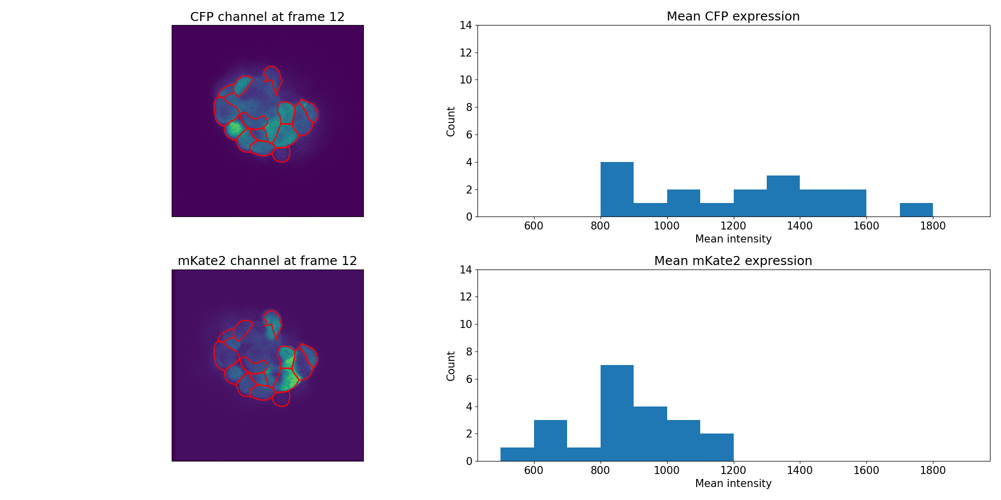
4. Mean intensity histogram
Notes:
Higher CFP expression made it a better choice for being the one used to create the segmentation masks.

Slide 12
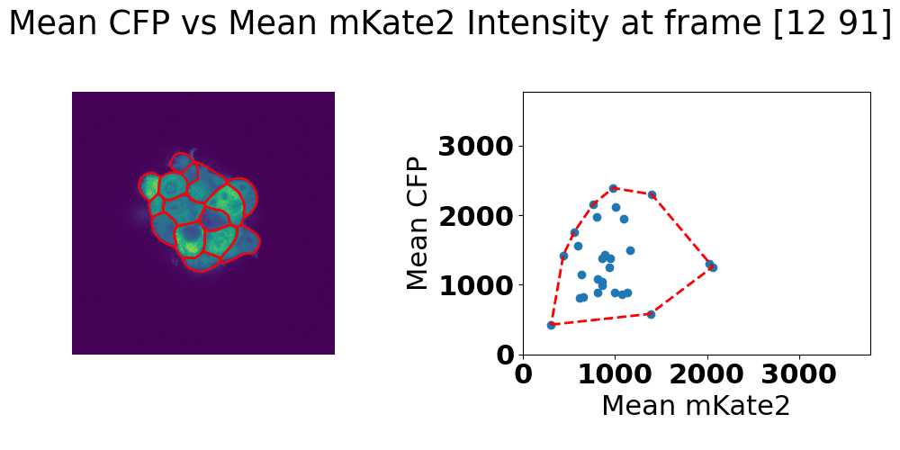
4. Scatter plot for visualization
Notes:
If there are below a certain amount of cells, should I remove that frame as an outlier? Happens towards the beginning or end where a frame has 6 cells compared to the center which has about 30.
Make picture bigger.

Slide 13
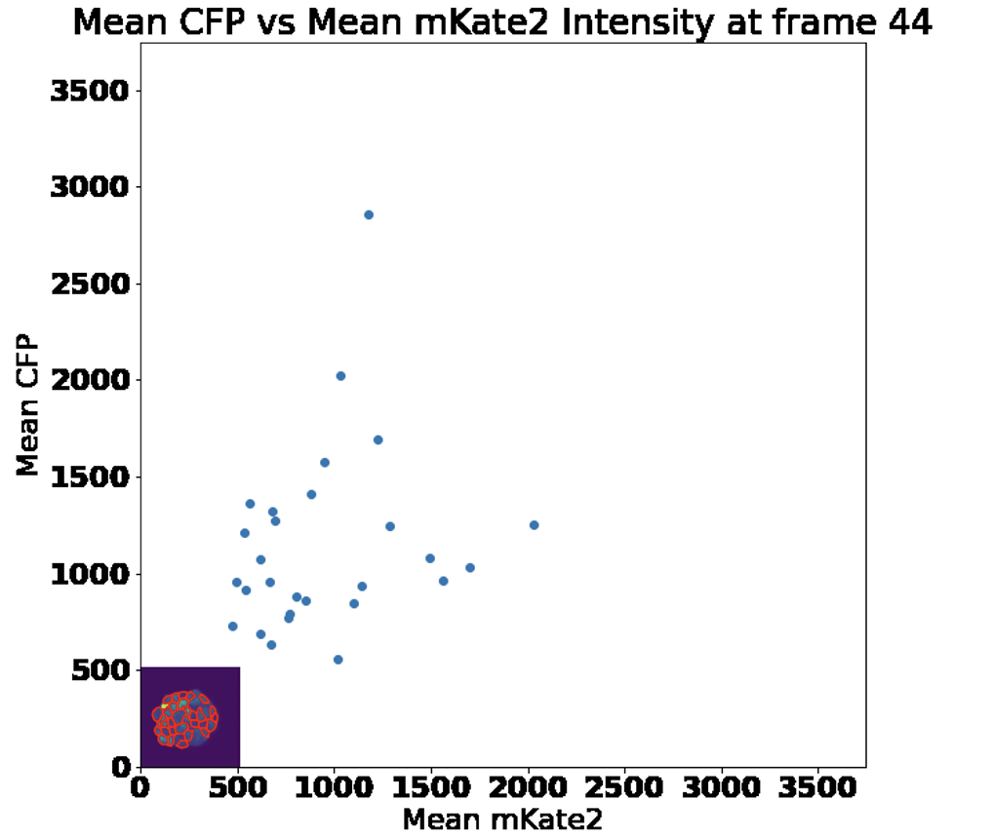
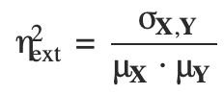
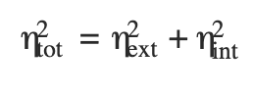
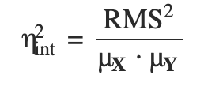
5. Noise decomposition
Intrinsic noise
Extrinsic noise
Tyler Quarton, Taek Kang, Vasileios Papakis, Khai Nguyen, Chance Nowak, Yi Li, Leonidas Bleris, Uncoupling gene expression noise along the central dogma using genome engineered human cell lines, Nucleic Acids Research. 2020
Notes:
Use formula from https://authors.library.caltech.edu/74808/3/%5BStatistical%20Applications%20in%20Genetics%20and%20Molecular%20Biology%5D%20Estimating%20intrinsic%20and%20extrinsic%20noise%20from%20single-cell%20gene%20expression%20measurements.pdf; same as the one from Elowitz on the slides.
Elowitz: https://pubmed.ncbi.nlm.nih.gov/12237400/

Slide 14
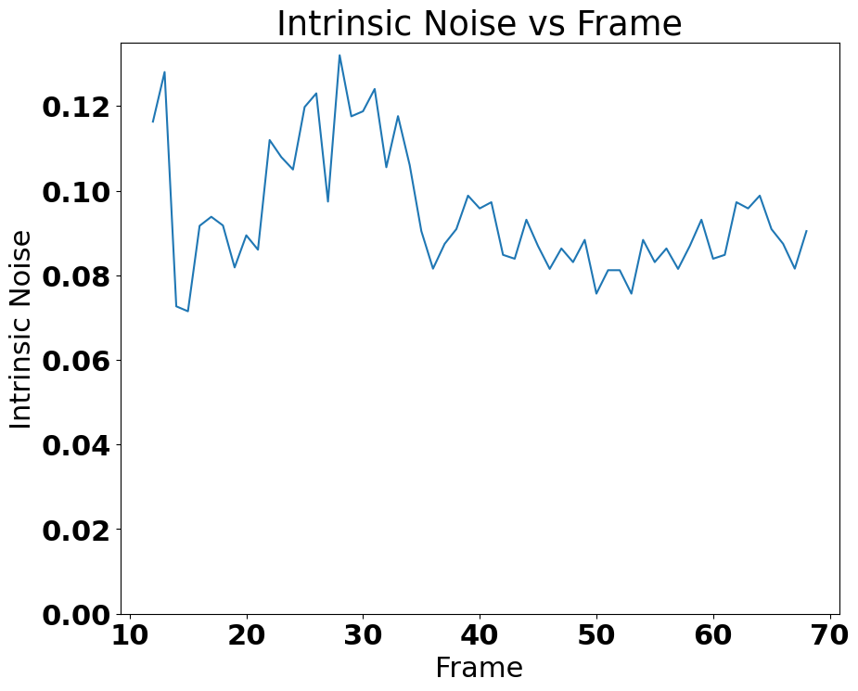
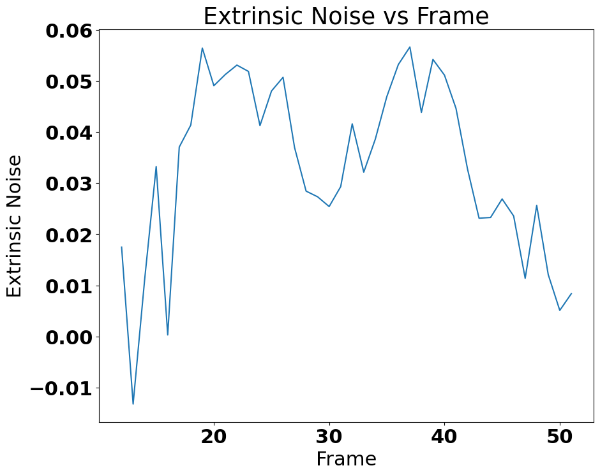
Intrinsic and extrinsic noise calculation
Notes:
The ends of the extrinsic noise being high could be because the segmentation is circling ones that are all black as well as the middle one with high expression. The overall trend doesn’t seem to have changed with fixing the offset. RMS for best fit intrinsic. Split spheroid into half and combine. Extrinsic is cv. Intrinsic is RMS.

Slide 15
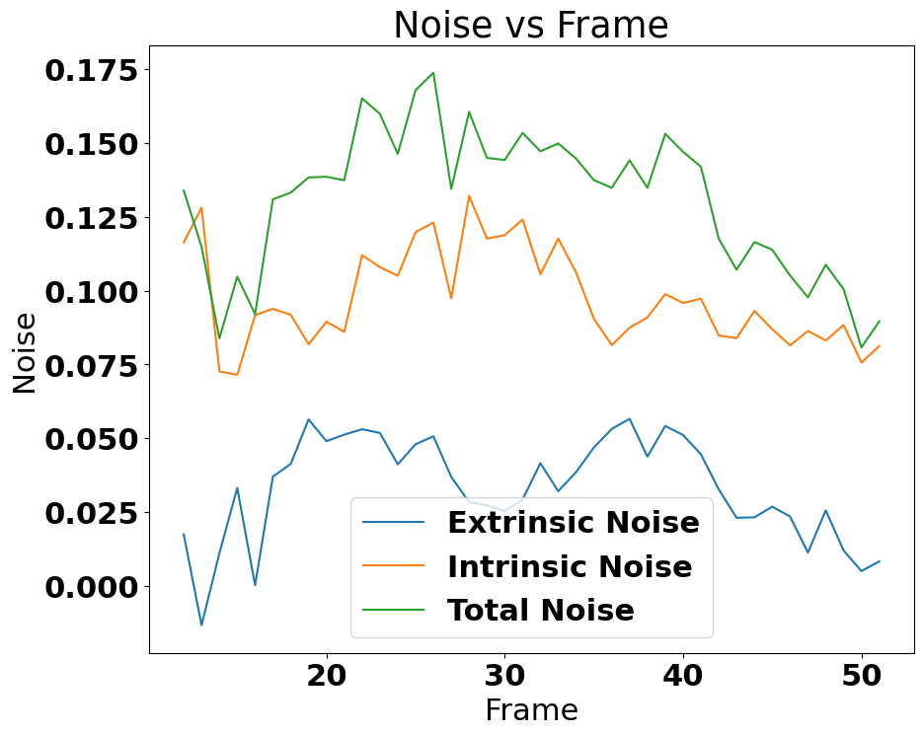
Total noise
Notes:
Overlay total noise and intrinsic and extrinsic

Slide 16
Noise analysis of segmented spheroid
Previous noise analysis was using the entire frame. The next analysis looks at noise after segmenting the frame to inner and outer.

Slide 17
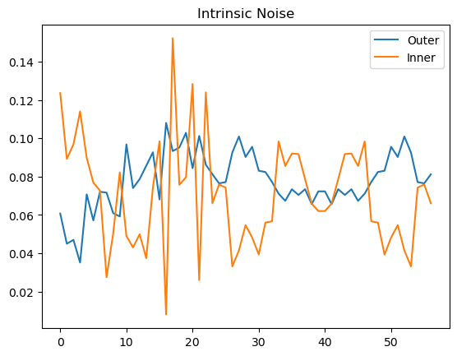
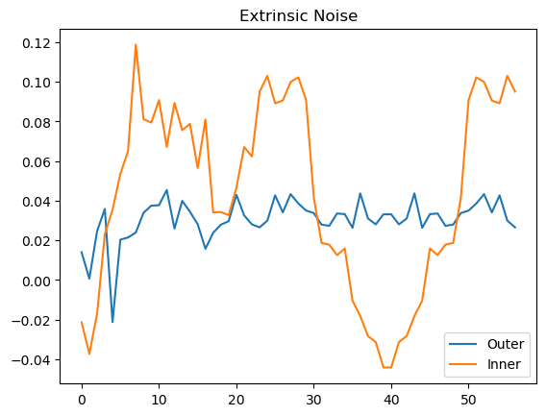
Noise for inner and outer

Slide 18
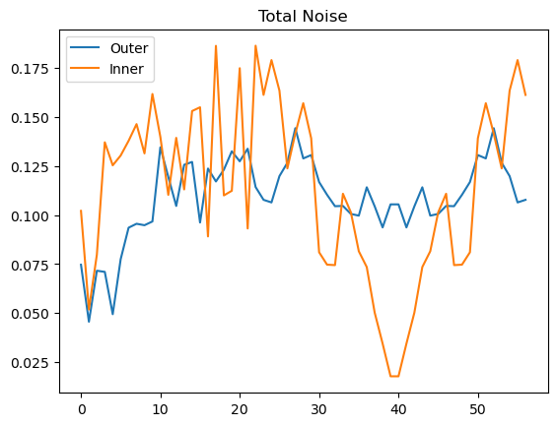
Inner and outer total noise

Slide 19
Inner and outer noise analysis of entire spheroid
There are points where the CV (extrinsic noise) is negative. This happens because of how few cells there are in each frame.
One solution is to fix the problem of low cell count is to combine the inner cells in every frame for analysis and likewise for outer. Then there is a single pair of values for intrinsic and extrinsic noise for each spheroid.

Slide 20
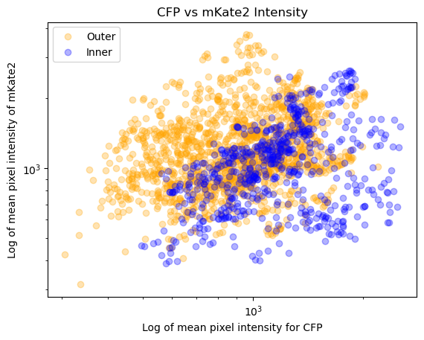
Scatter plot of entire spheroid

Slide 21
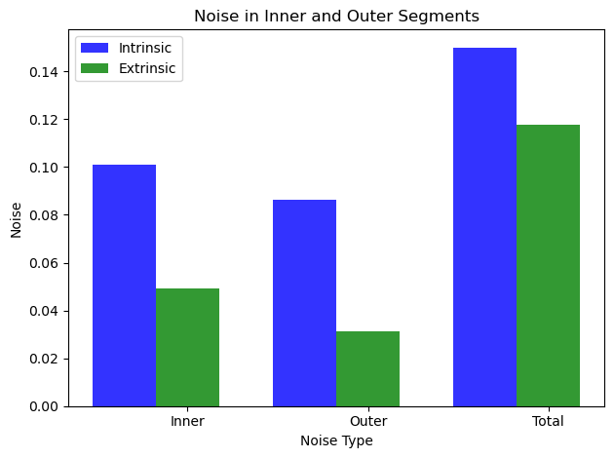
Noise analysis over entire spheroid

